Slide 1
‘Users allow’ Single Value

Slide 2
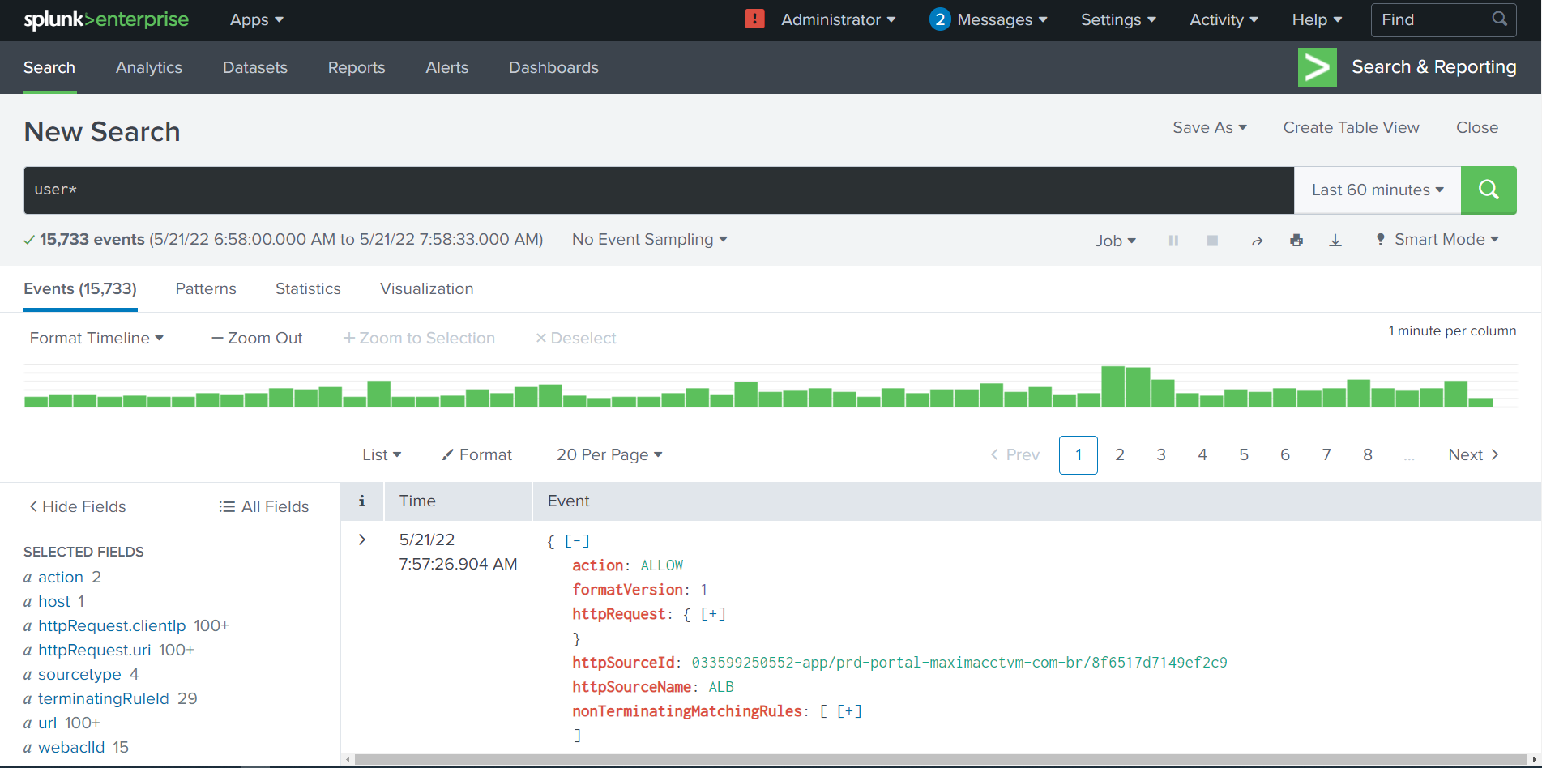
user*

Slide 3
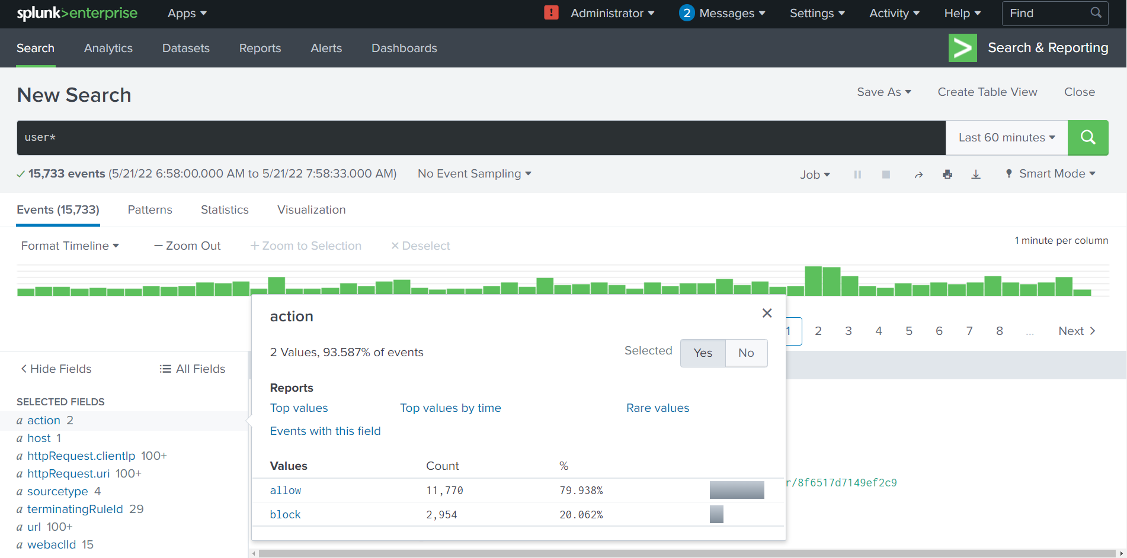

Slide 4
user* action=allow

Slide 5
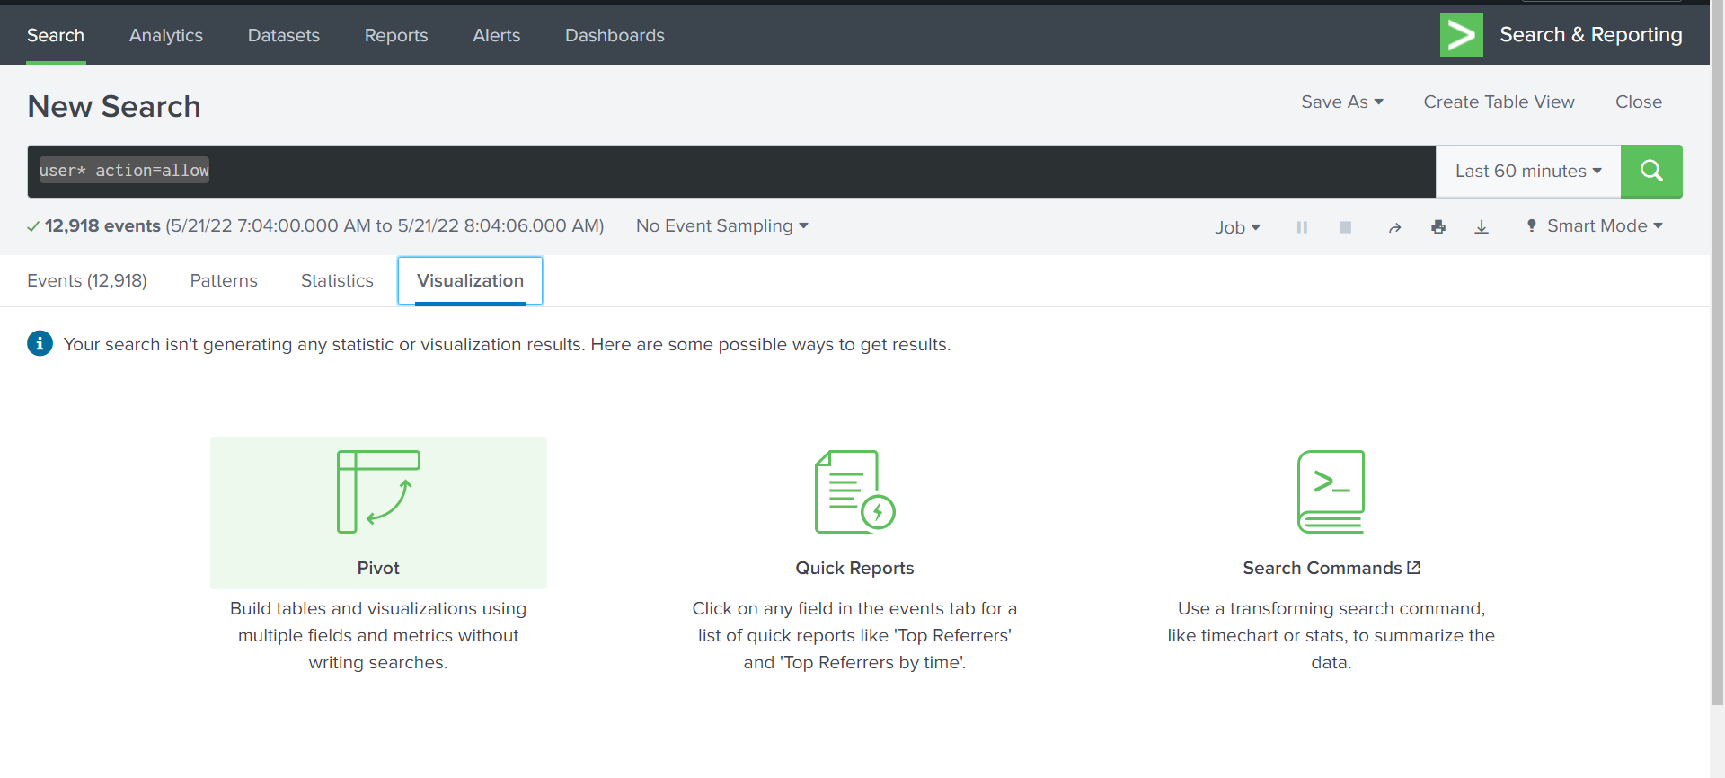
Click ‘visualization’
Click ‘pivot’

Slide 6
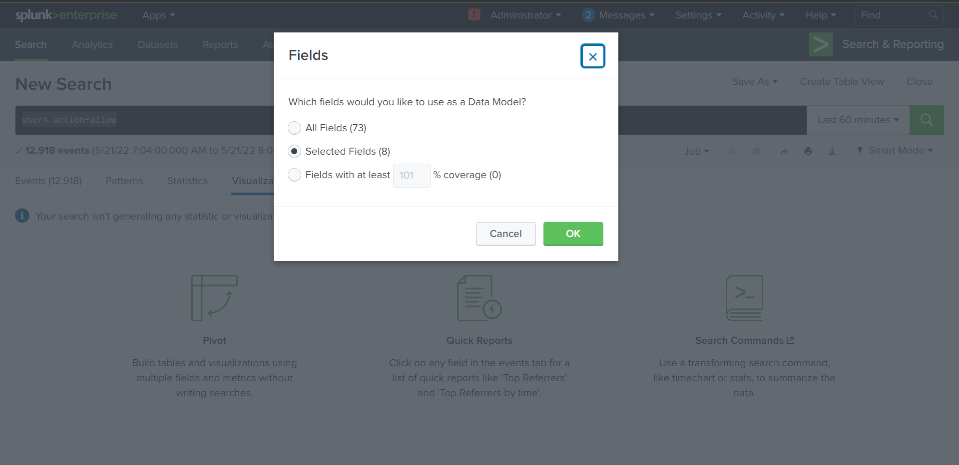
Only selected fields

Slide 7
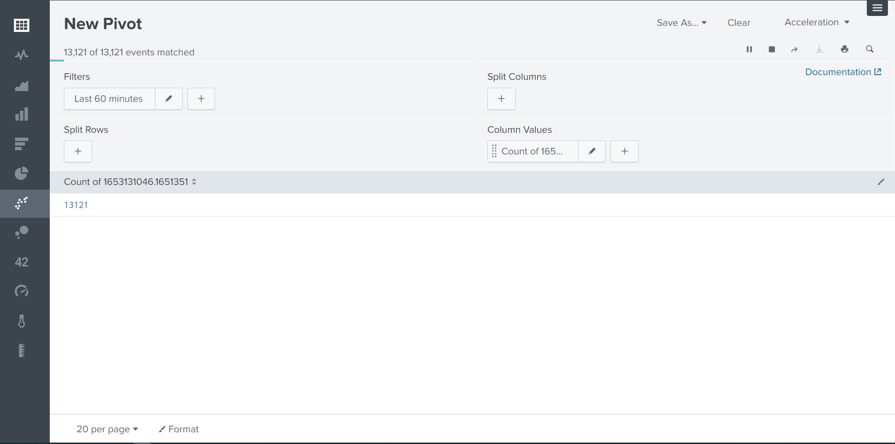
Check filters
Results

Slide 8
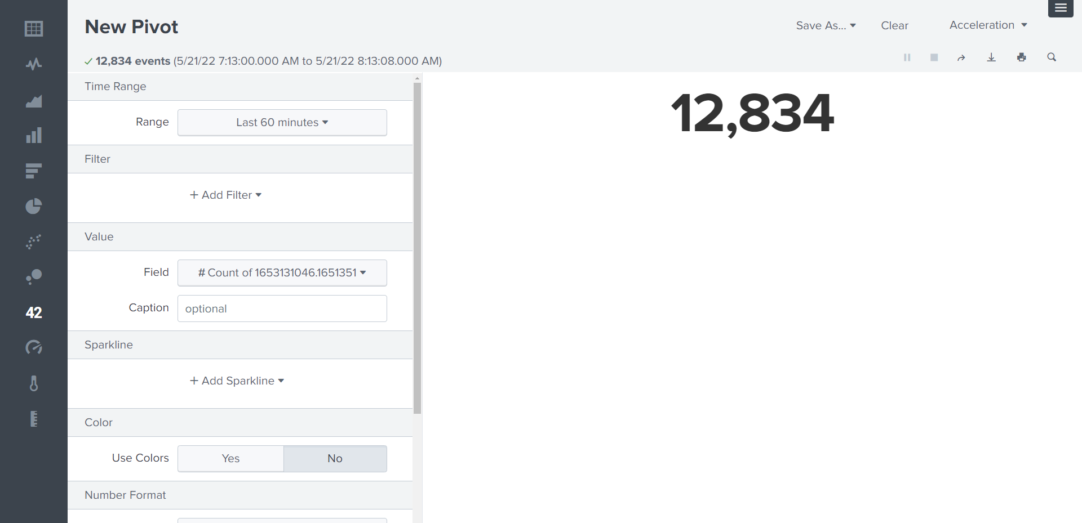
Click on ‘single value’

Slide 9
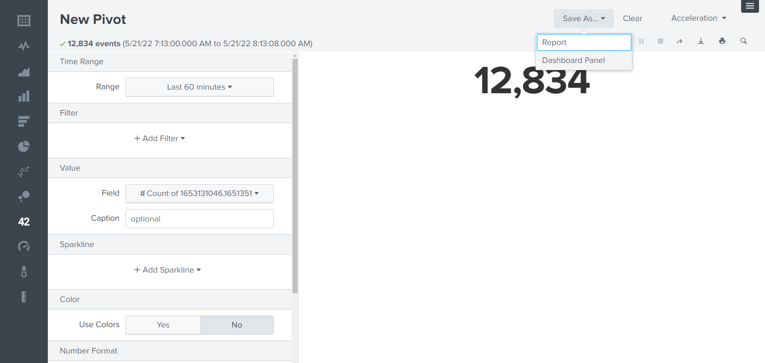

Slide 10
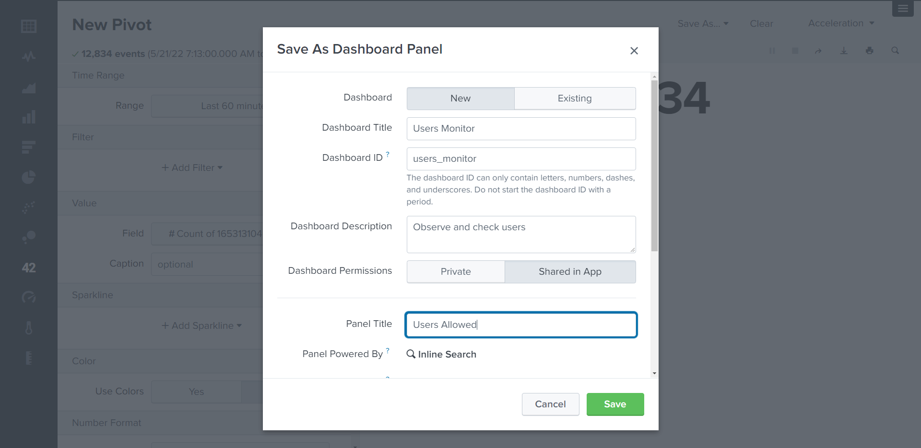
Use title ‘Users Monitor’
Fill description ‘Observe and check users’
Share the dashboard
Share the dashboard

Slide 11
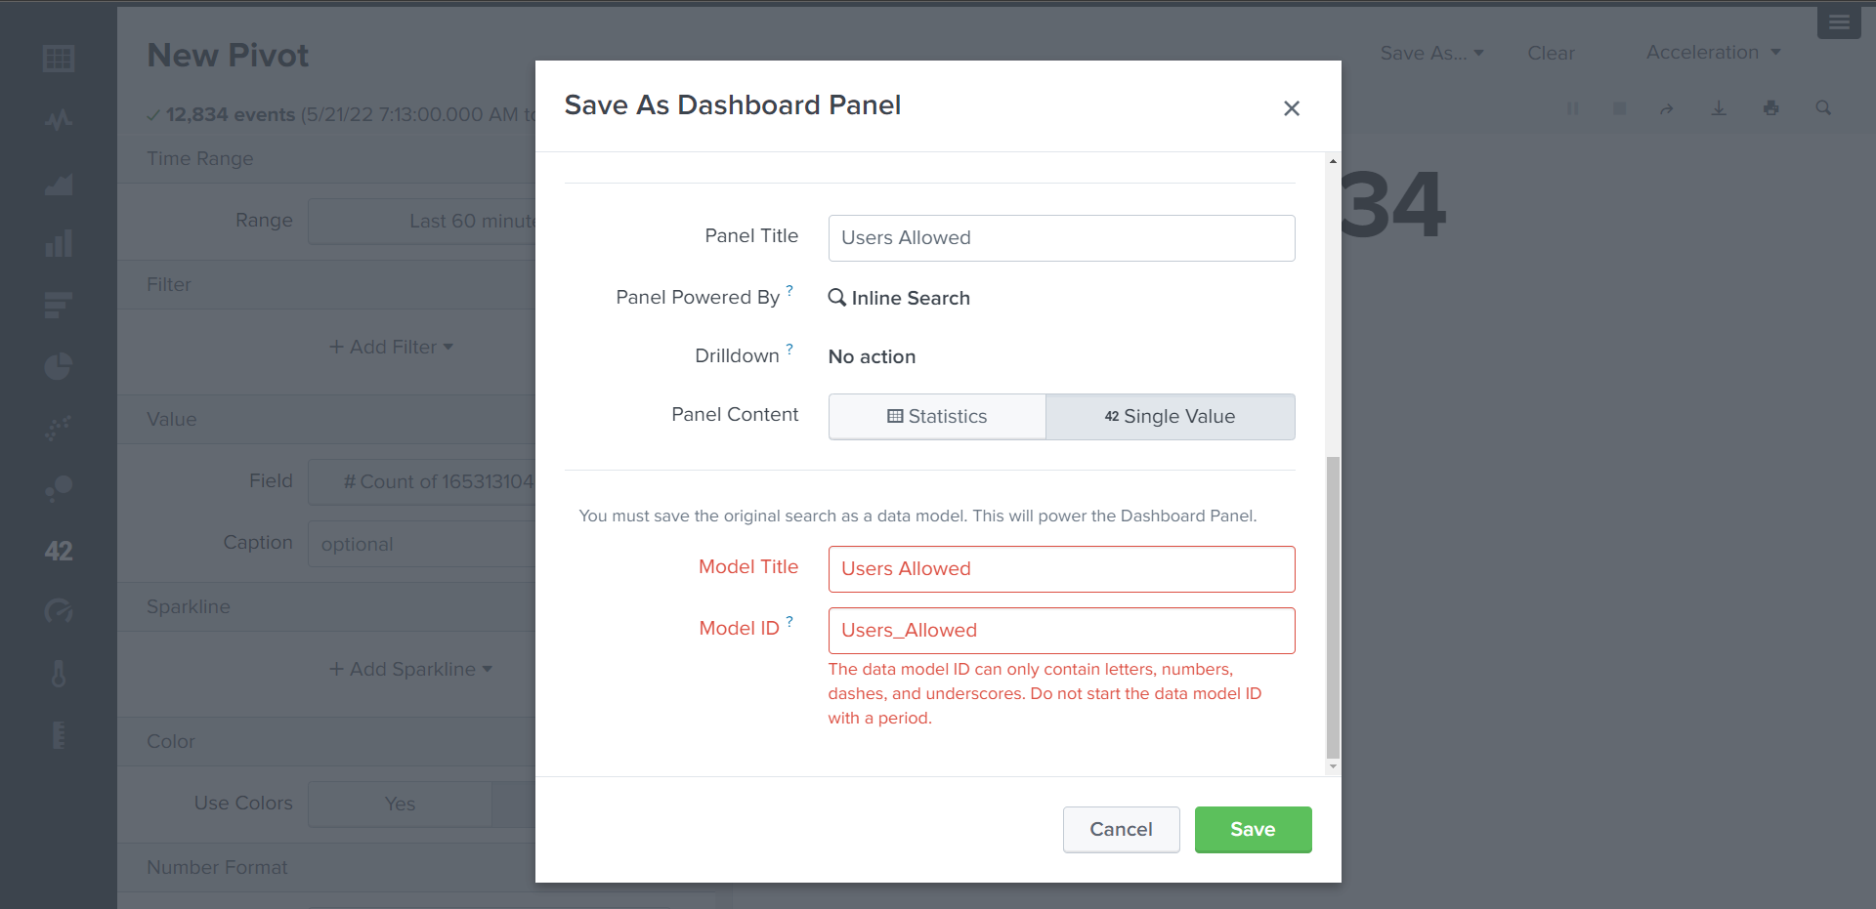
Titles and model must be fill

Slide 12
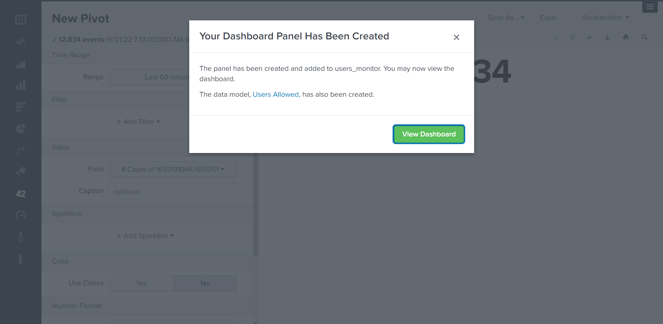
View the dashboard

Slide 13
user*

Slide 14
‘Users block’ Single Value

Slide 16
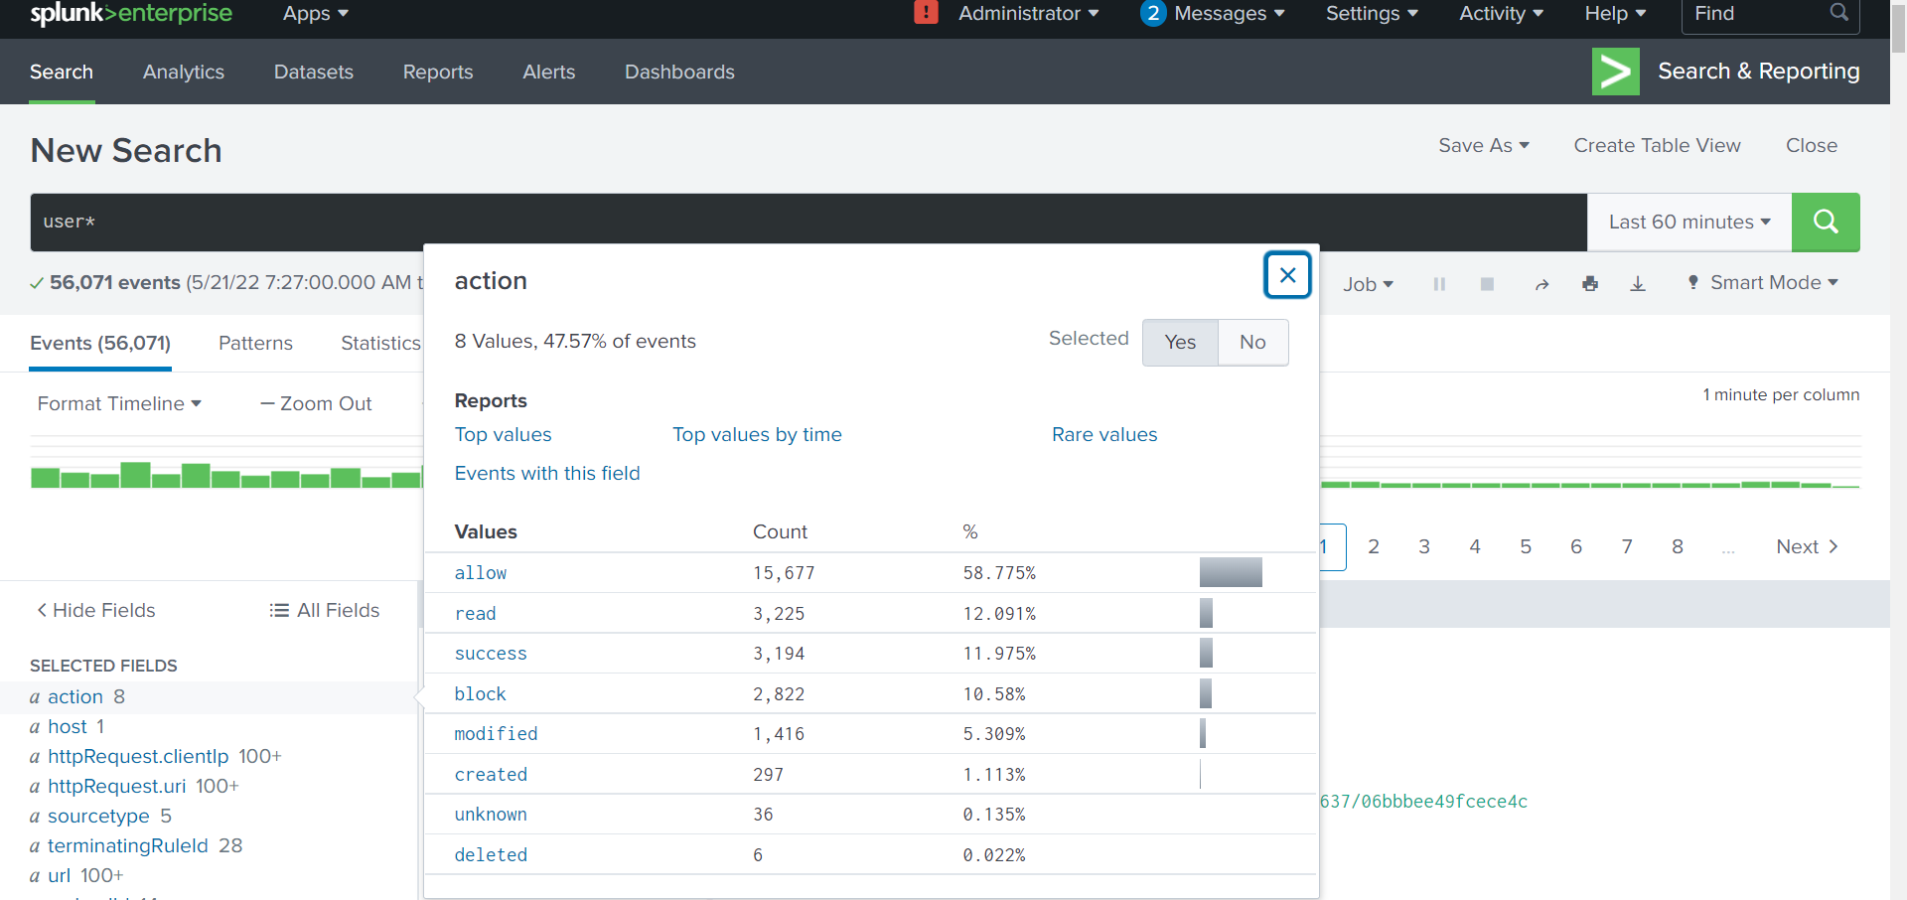
user* action=block

Slide 17
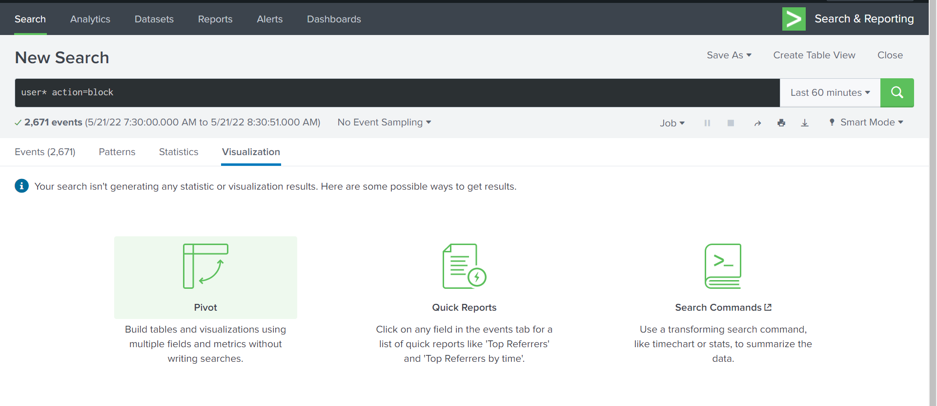
Click ‘visualization’
Click ‘pivot’

Slide 18
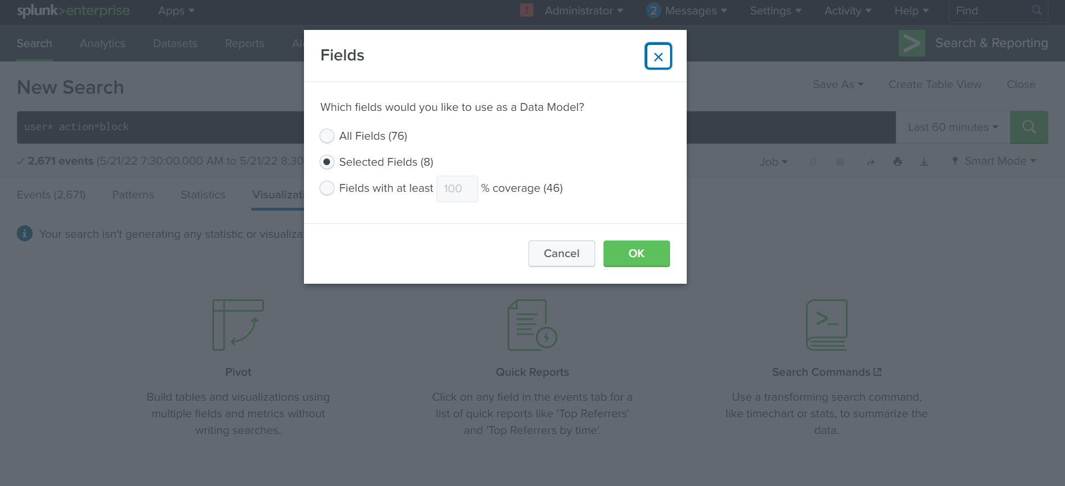
Only selected fields

Slide 19
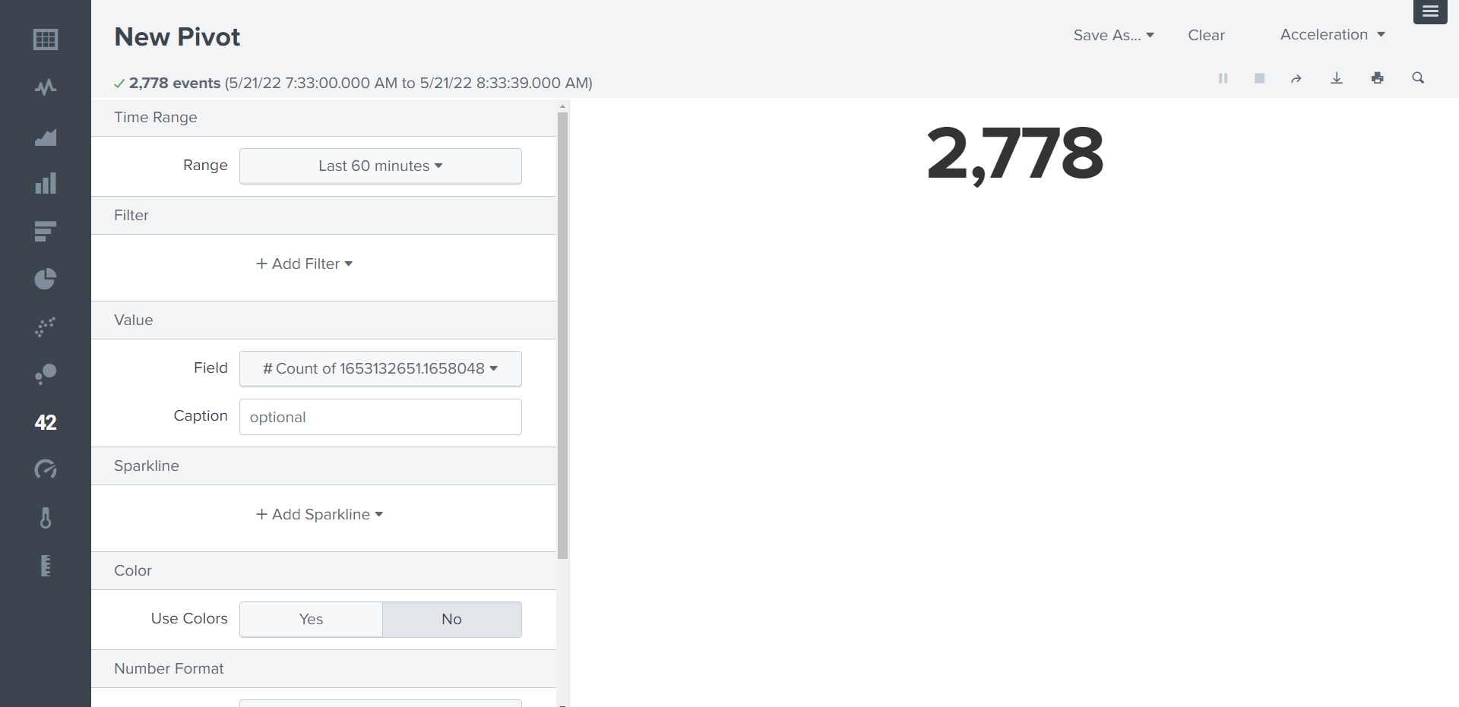
Single Value

Slide 20
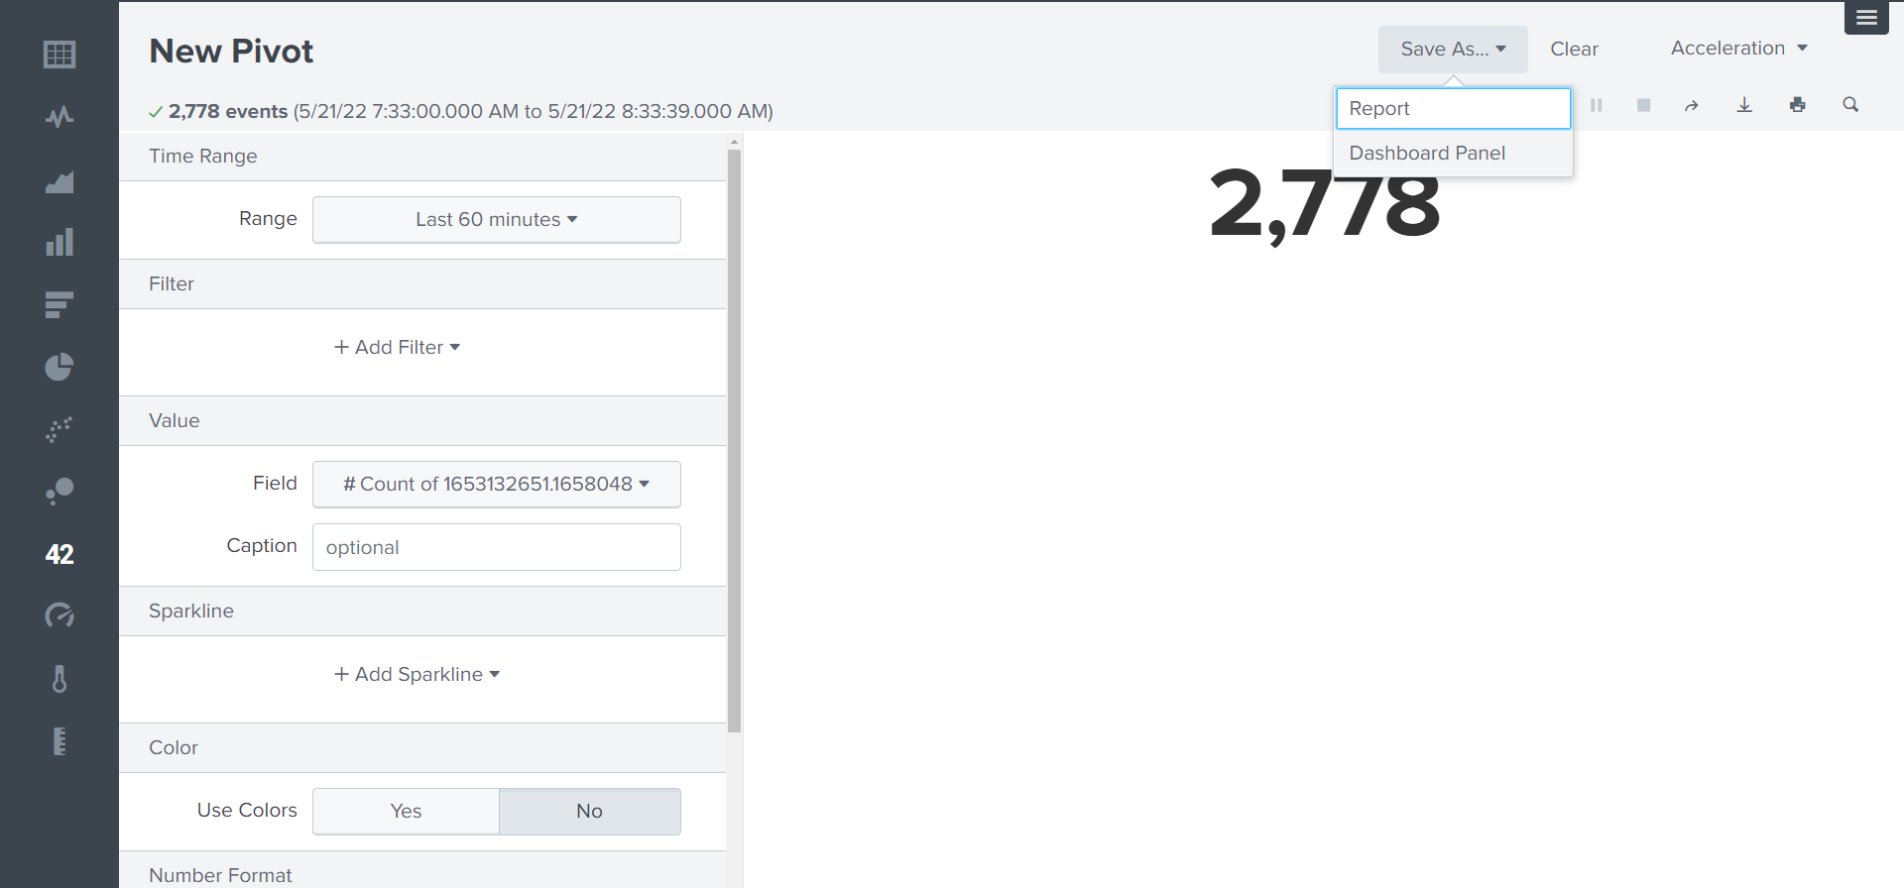
Go to ‘dashboard panel’

Slide 21
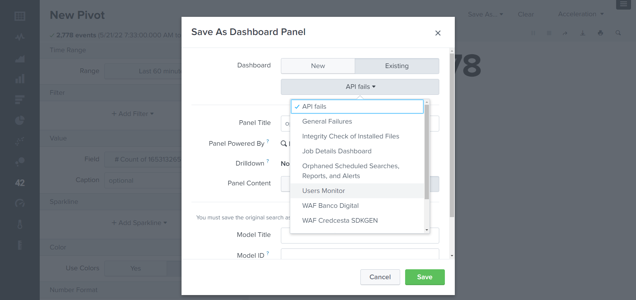
Go to ‘dashboard panel’

Slide 22
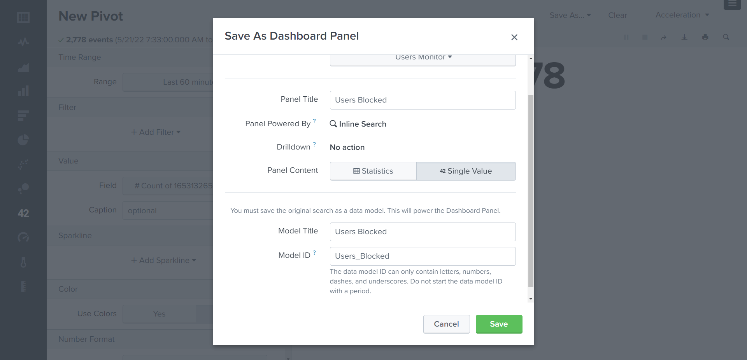
Fill ‘titles’ fields

Slide 23
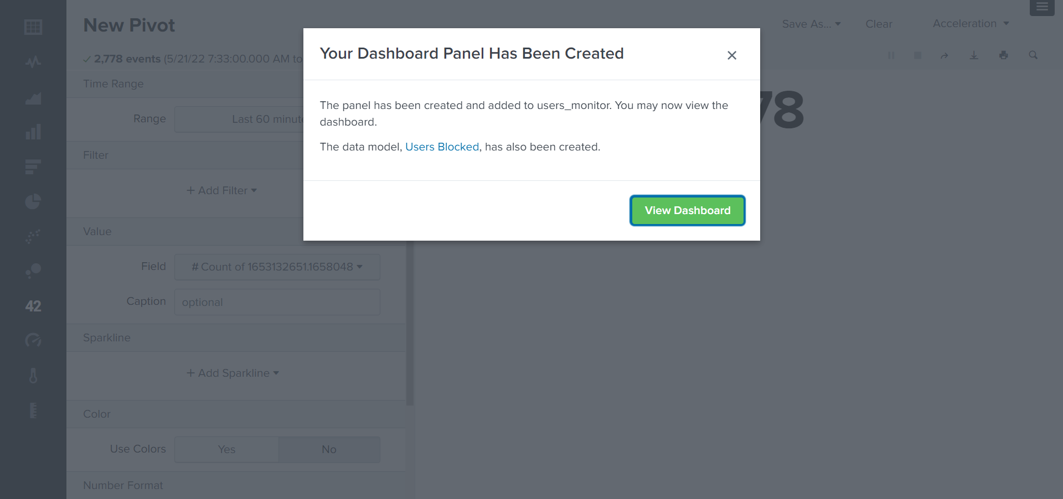
View Dashboard

Slide 24
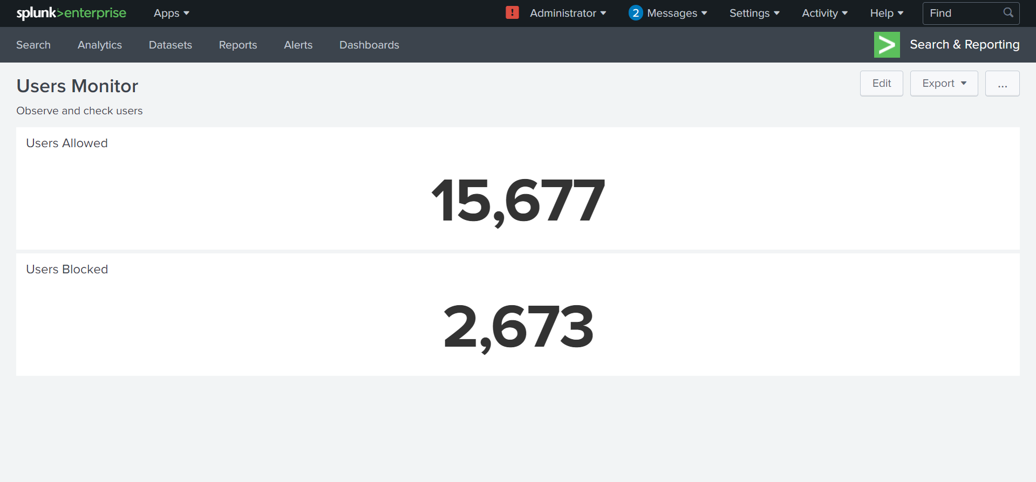
Fill ‘titles’ fields

Slide 25
All Action in pizza chart

Slide 26
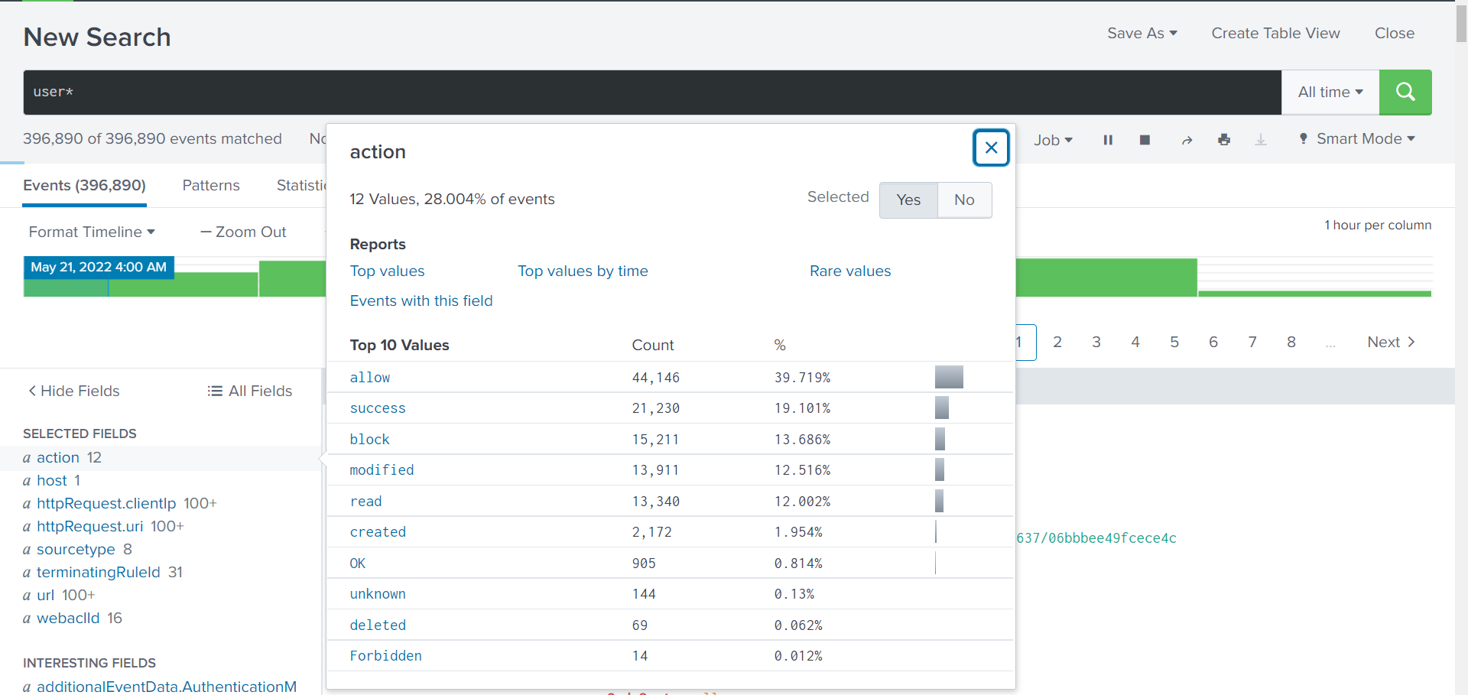
Actions
Raise time for ‘all’
Only top values

Slide 27
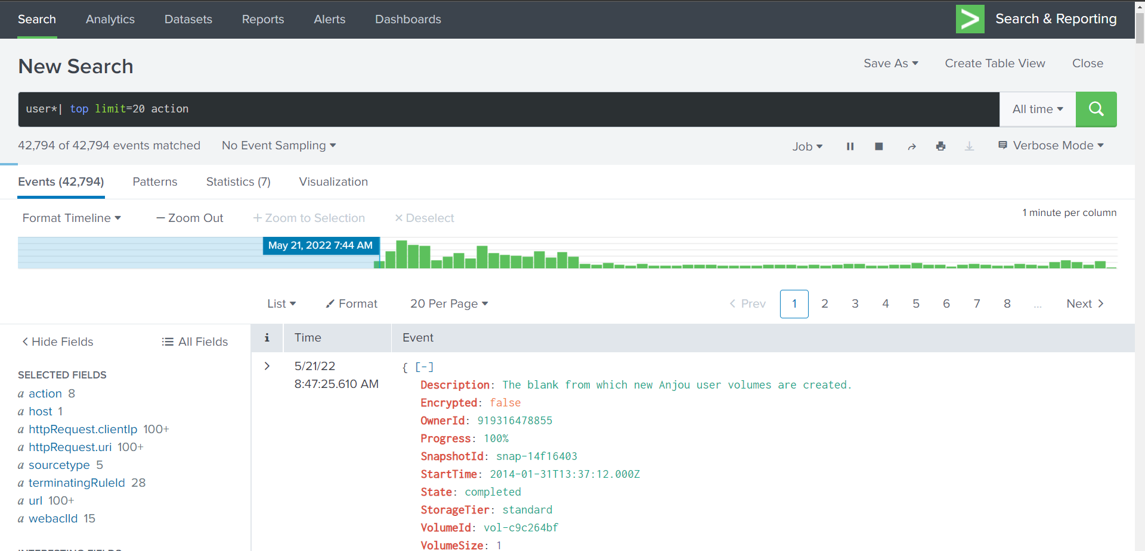
Results top 20

Slide 28
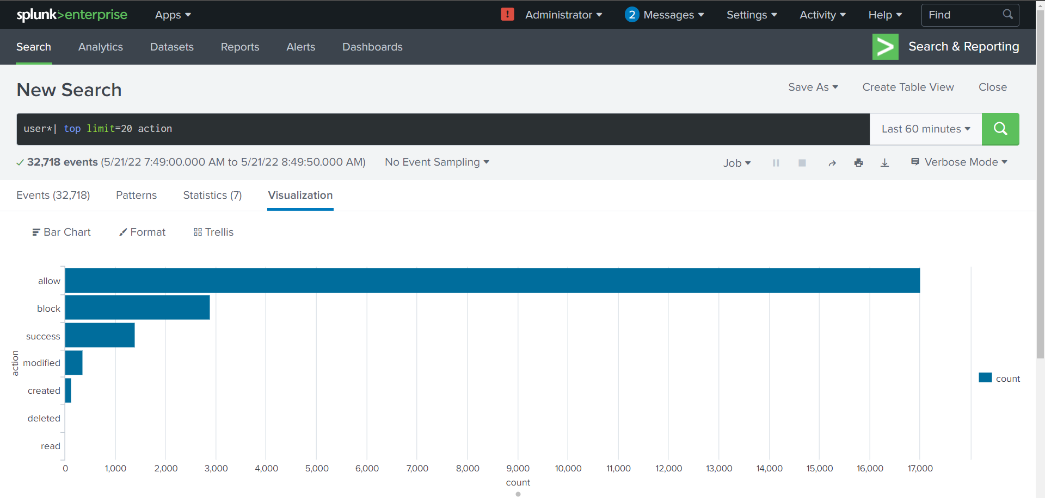
Viz result

Slide 29
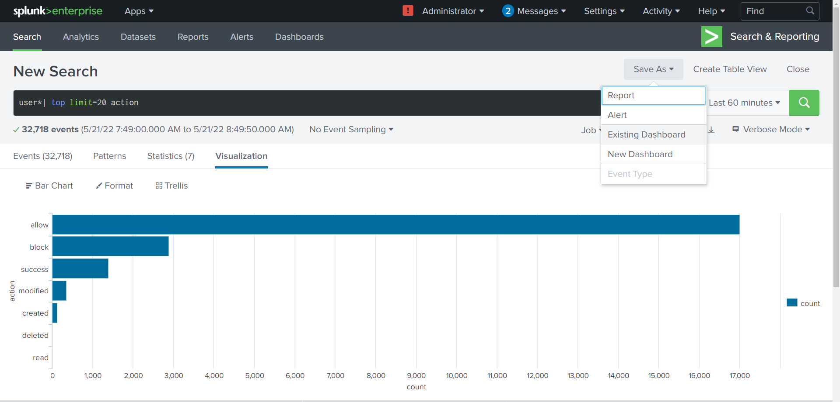
Existing dashboars

Slide 30
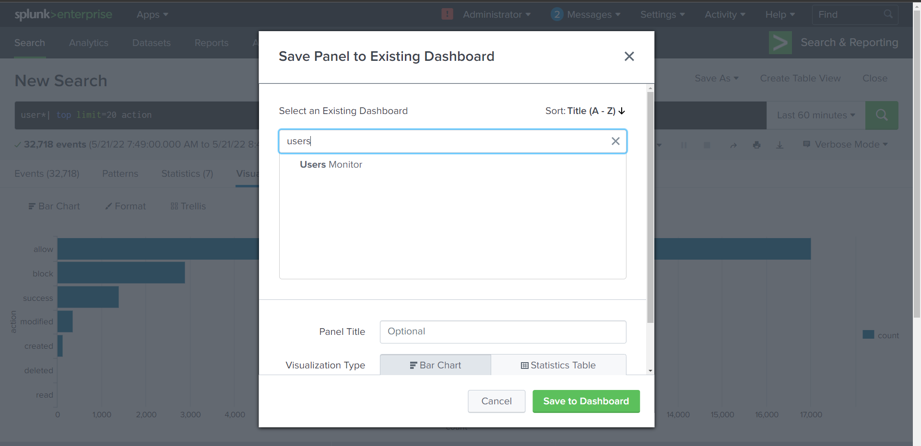
Search for ‘users monitor’

Slide 31
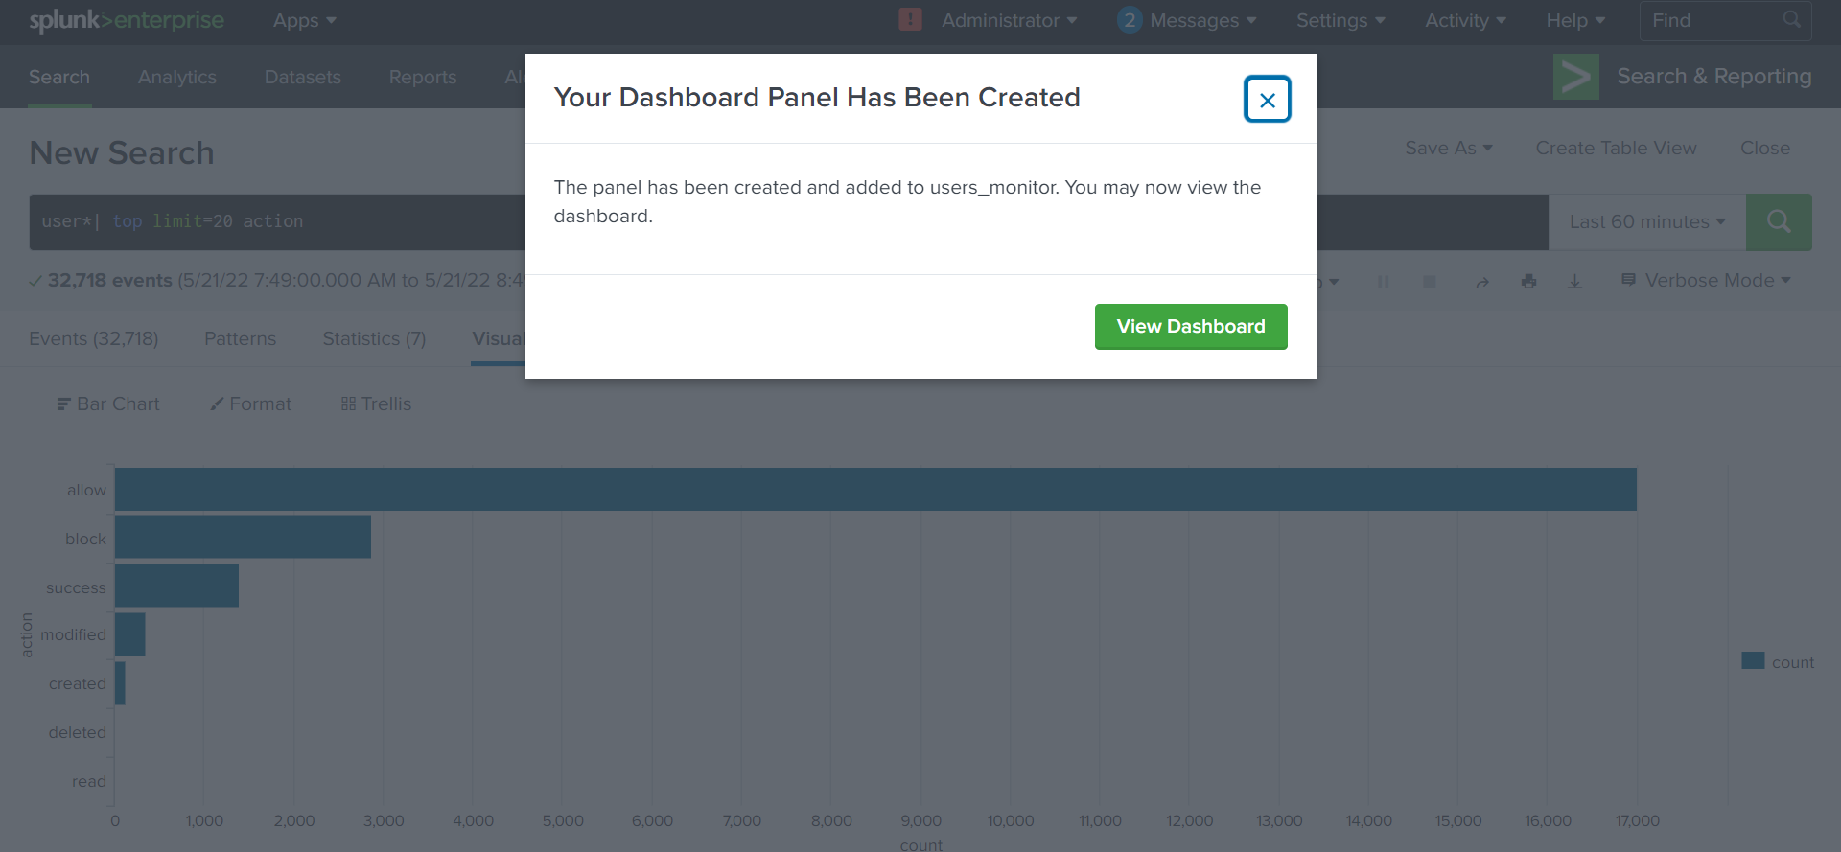
View DashBoard

Slide 32
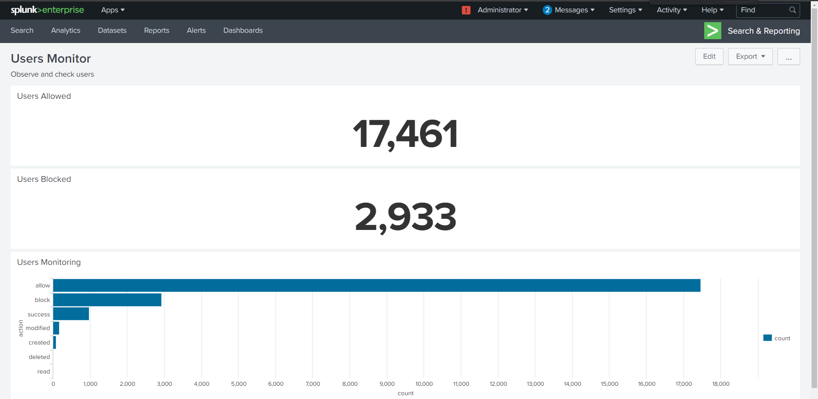
3 objects in a dashboard
Edit dashboard

Slide 33
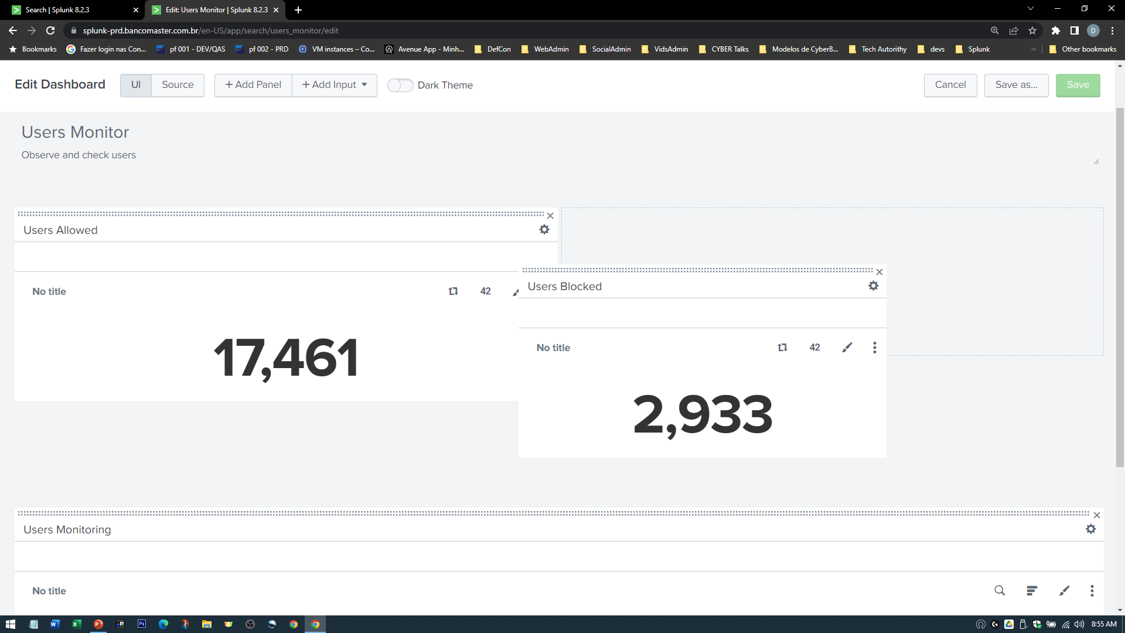
Drag the objects

Slide 34
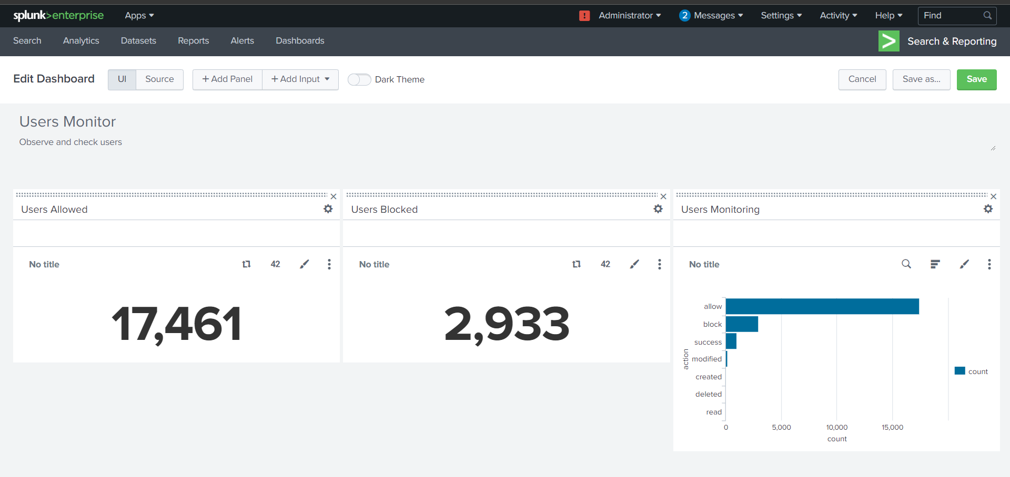
Save

Slide 35
